Slide 1
Delinquency
a failure to pay an outstanding debt by the due date.
Or
neglect of one's duty.

Slide 2
Problem Statement
As a business owner, Almost everyone at some stage faced the situation where they have a delinquent account where a customer or client has failed to pay, and dealing with this delinquent account and general customer delinquency can be a stressful and time-consuming process.
After all, in the early days of any business, it is cash flow that is the most important aspect and if cash flow is being negatively impacted by a customer or client who has not settled his delinquent account, Businesses could find themselves running out of money.
Objective : To Deal with this situations we will build a system which after analysing the customer previous history on basis of many attributes and trying to predict if that customer account will be delinquent or non delinquent.

Slide 3
Data Dictionary
Variable Name | Description | Type
SeriousDlqin2yrs | Person experienced 90 days past due delinquency or worse | Y/N
RevolvingUtilizationOfUnsecuredLines | Total balance on credit cards and personal lines of credit except real estate and no installment debt like car loans divided by the sum of credit limits | percentage
age | Age of borrower in years | integer
NumberOfTime30-59DaysPastDueNotWorse | Number of times borrower has been 30-59 days past due but no worse in the last 2 years. | integer
DebtRatio | Monthly debt payments, alimony,living costs divided by monthy gross income | percentage
MonthlyIncome | Monthly income | real
NumberOfOpenCreditLinesAndLoans | Number of Open loans (installment like car loan or mortgage) and Lines of credit (e.g. credit cards) | integer
NumberOfTimes90DaysLate | Number of times borrower has been 90 days or more past due. | integer
NumberRealEstateLoansOrLines | Number of mortgage and real estate loans including home equity lines of credit | integer
NumberOfTime60-89DaysPastDueNotWorse | Number of times borrower has been 60-89 days past due but no worse in the last 2 years. | integer
NumberOfDependents | Number of dependents in family excluding themselves (spouse, children etc.) | integer

Slide 4
Renaming Variables
Raw_Variables_Name | Renamed_Variable_Name
RevolvingUtilizationOfUnsecuredLine | "RUOUL"
NumberOfTime30-59DaysPastDueNotWorse | ThirtyToFiftyNine
NumberOfOpenCreditLinesAndLoans | "OCLL"
NumberOfTimes90DaysLate | "NintyDaysLate"
NumberRealEstateLoansOrLines | "RELL"
NumberOfTime60-89DaysPastDueNotWorse | SixtyToEightyNine
NumberOfDependents | "NOD"

Slide 5
Data
Values
Column | Total_observations | Number of Null Values | Proportion
SeriousDlqin2yrs | 150000 | 0 | 0
RUOUL | 150000 | 0 | 0
age | 150000 | 0 | 0
ThirtyToFiftyNine | 150000 | 0 | 0
DebtRatio | 150000 | 0 | 0
MonthlyIncome | 150000 | 29731 | 0.198207
OCLL | 150000 | 0 | 0
NintyDaysLate | 150000 | 0 | 0
RELL | 150000 | 0 | 0
SixtyToEightyNine | 150000 | 0 | 0
NOD | 150000 | 3924 | 0.02616
MonthlyIncome and NumberOfDependents have 29731 (19.82%) and 3924 (2.61%) null values respectively

Slide 6
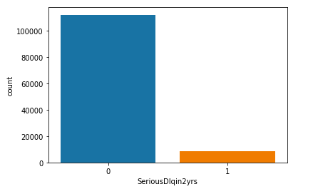
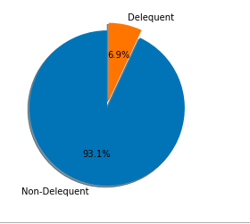
SeriousDlqin2yrs
Categories | Categories | Count
0 | Non-Delinquent | 111912
1 | Delinquent | 8357
Around 6.9 % of the accounts are Delinquent

Slide 7
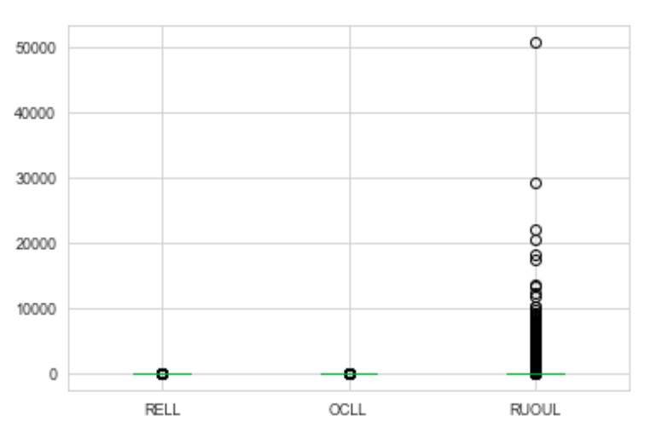
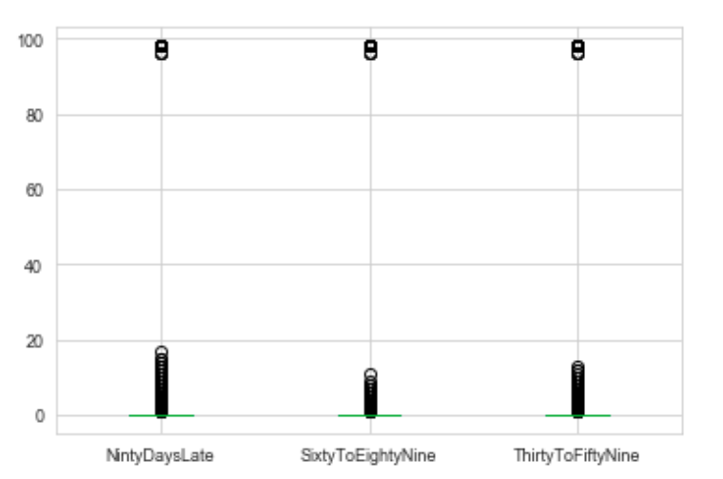
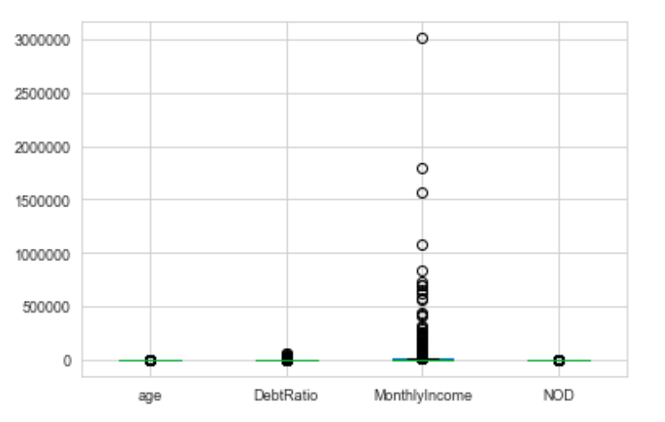
Outliers Detection

Slide 8
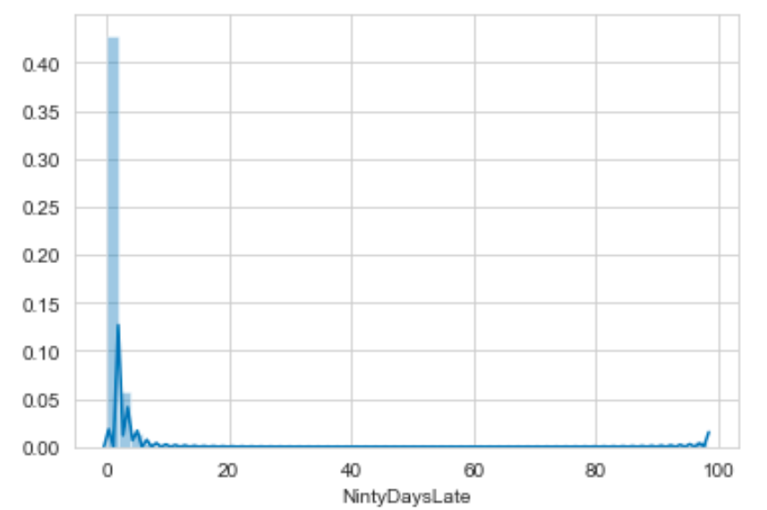
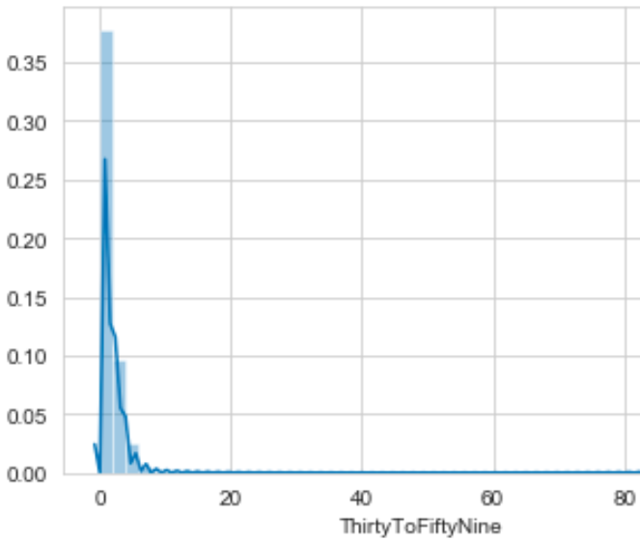
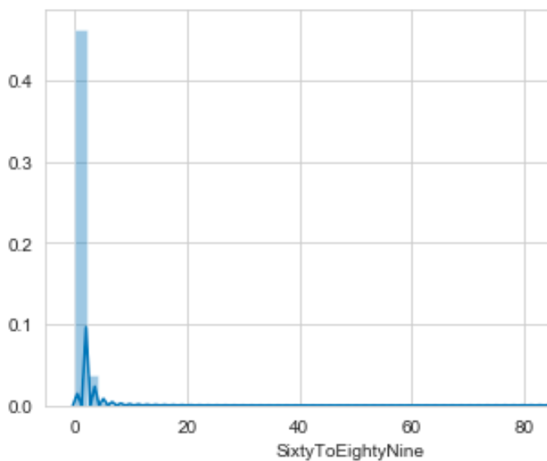
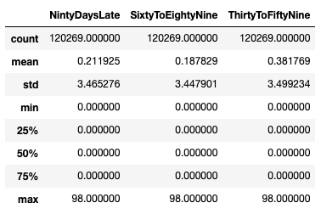
Late Payment By Days The data is positively skewed for all the late payment variables for all the delinquent accounts, which shows that that the data is not at all symmetrical.

Slide 9
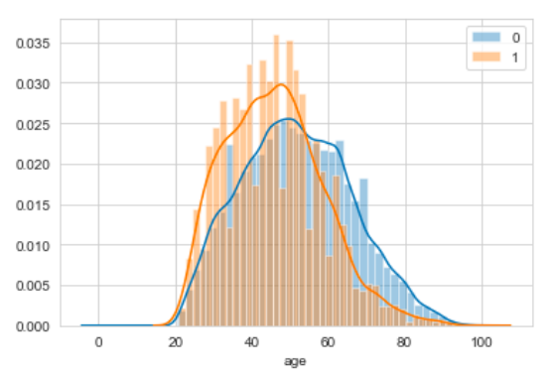
Age vs SeriousDlqin2yrs
Most of the accounts which are non-delinquent are at older age group as compared to delinquent accounts.

Slide 10
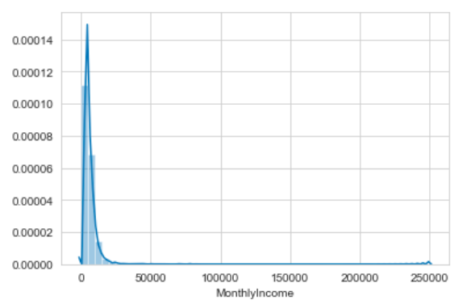
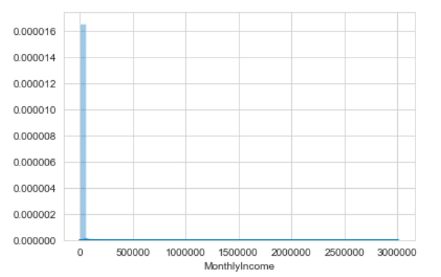
MonthlyIncome vs Delinquent account Monthly income for delinquent account are positively skewed with most people falling in salary range between 0 -500000.

